Slide 1
Deploying Microservices on OpenShift
Martin Lee
Github : https://github.com/leeyeekee
LinkedIn : https://www.linkedin.com/in/martin-yee-kee-lee-272b21/

Slide 2




Context
getAll
add
Express/EJS
Json Body Parser
Axios
Spring Framework
JPA
REST
MySQL Connector
Persistent Volume
Record
ID
Name
Address

Slide 3
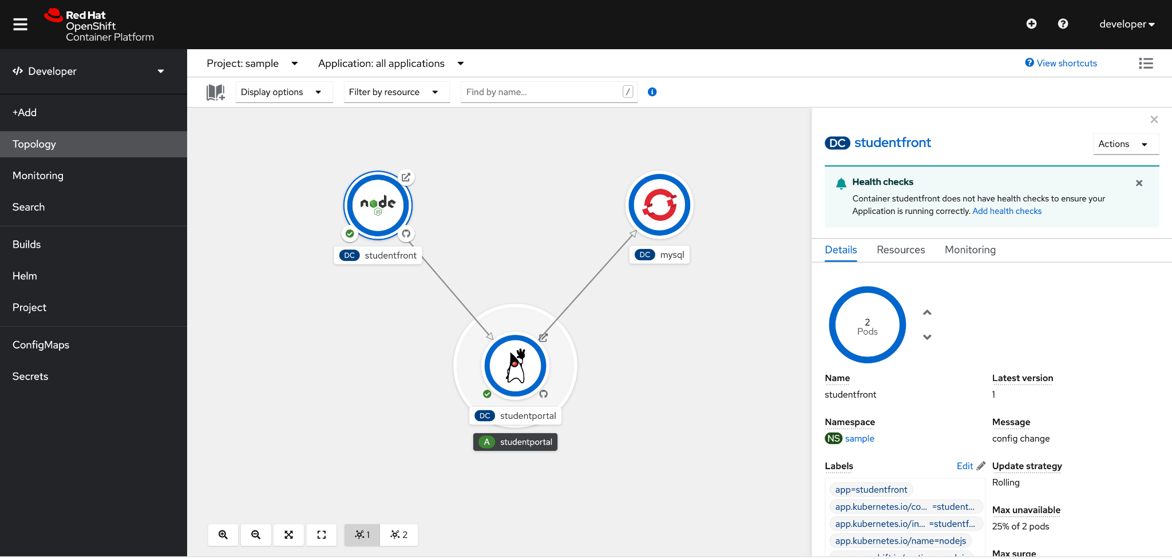
Demonstration
Provision an OpenShift Sandbox
Deploy the Front End, Backend Rest API, DB Services
Wired the Services

